Slide 1

CRYSTAL BALL

Slide 2
Agenda
Problem Statement
Crystal Ball - One Stop Healthcare Solution
Multithreaded Simulation Model
Data Visualization Through Dashboards
Information Through FAQs & Chatbot
Extend & Seek Help
Solution Architecture
Future Roadmap
Demo
Q/A

Slide 3


About Us
Our team consists of 2 members:
Prisha Goel
NPS Grade 12 student
Loves Python & Database Programming
Pranshu Goel
NPS Grade 9 student
Passionate coder, mentors underprivileged students

Slide 4
Problem Description
COVID19 has changed the way we live our lives
Lack of authorized information creates panic in the society
Need for centralized portal for residents to check bed availability in nearby centres
Tools to enable people to seek information interactively
Need to connect those who can help each other

Slide 5
SOLUTION DESIGN

Slide 6
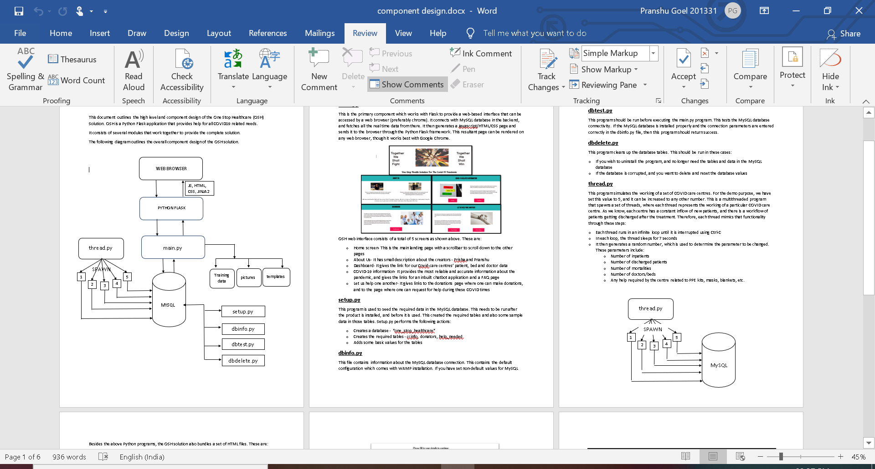
Solution Architecture

Slide 7
PROJECT DEMO

Slide 8


Slide 9
ADDITIONAL SLIDES

Slide 10
Installation and Configuration
Setup.py – Creates MySQL tables and seed data
Dbinfo.py – Contains MySQL database connection information
Dbtest.py – Test utility for checking the database connectivity
Dbdelete.py – Database clean-up tool

Slide 11
Future Roadmap
Extend the simulation program to actually connect with the real central database
Use Google maps to locate the nearest available COVID care centre

Slide 12


COVID Care Centre Simulation
Multithreaded Python program
Creates 5 threads, where each thread simulates the operations of a COVID care centre
Use a random number to alter
Active patients
Discharged patients
Mortalities
Number of beds/doctors
Help needed by the centre

Slide 13
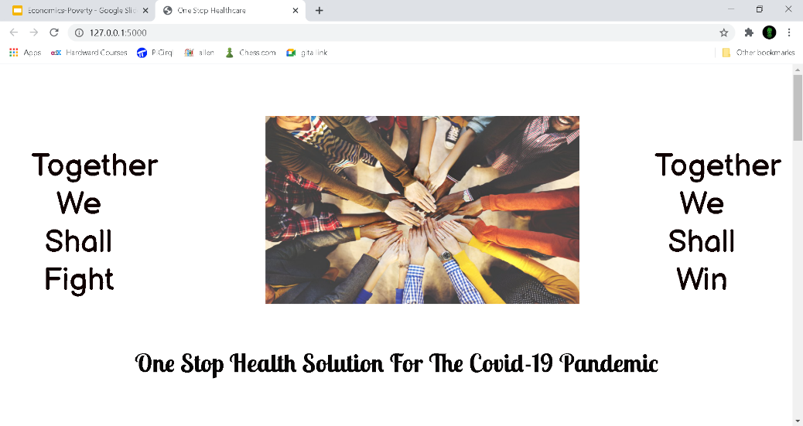
Crystal Ball - One Stop Healthcare Solution
The solution consists of:
Integrated set of services
Multithreaded simulation program
Web based user interface
Centralized real time dashboard
FAQs and Chatbot program
Connect needy with the donators

Slide 14
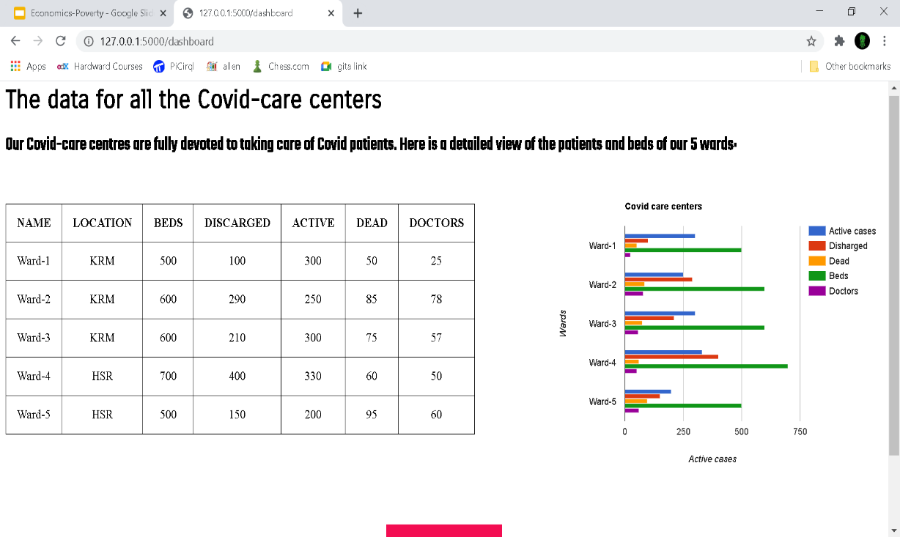
Data Visualization
Shows real time data for all COVID care centres nearby
Currently shows 5 wards, but can be extended to cover more
Shows data about
Currently active patients
Discharged patients
Mortalities
Number of beds and doctors
Useful for patients who need admission into a centre

Slide 15
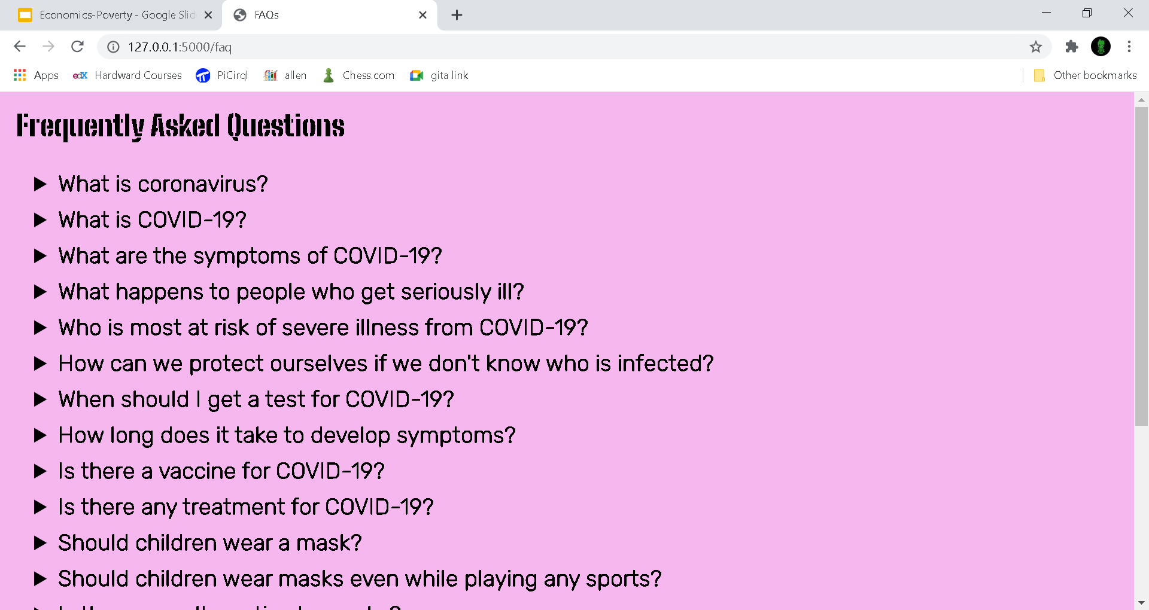
COVID19 FAQs
Interactive list of most frequently asked questions about COVID19
Part of the web based interface
Helps reduce panic and stress in the society by providing relevant information

Slide 16
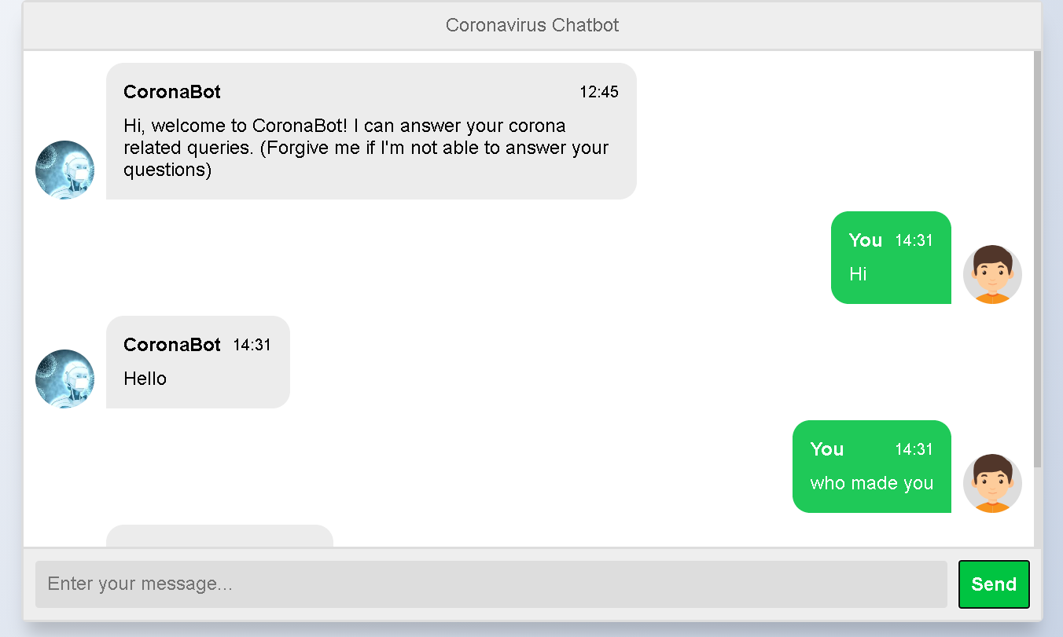
COVID19 Chatbot
Highly interactive chatbot program which provides human-like communication capabilities
We have fed most relevant questions that people may have about the pandemic
Based on Python chatterbot module

Slide 17
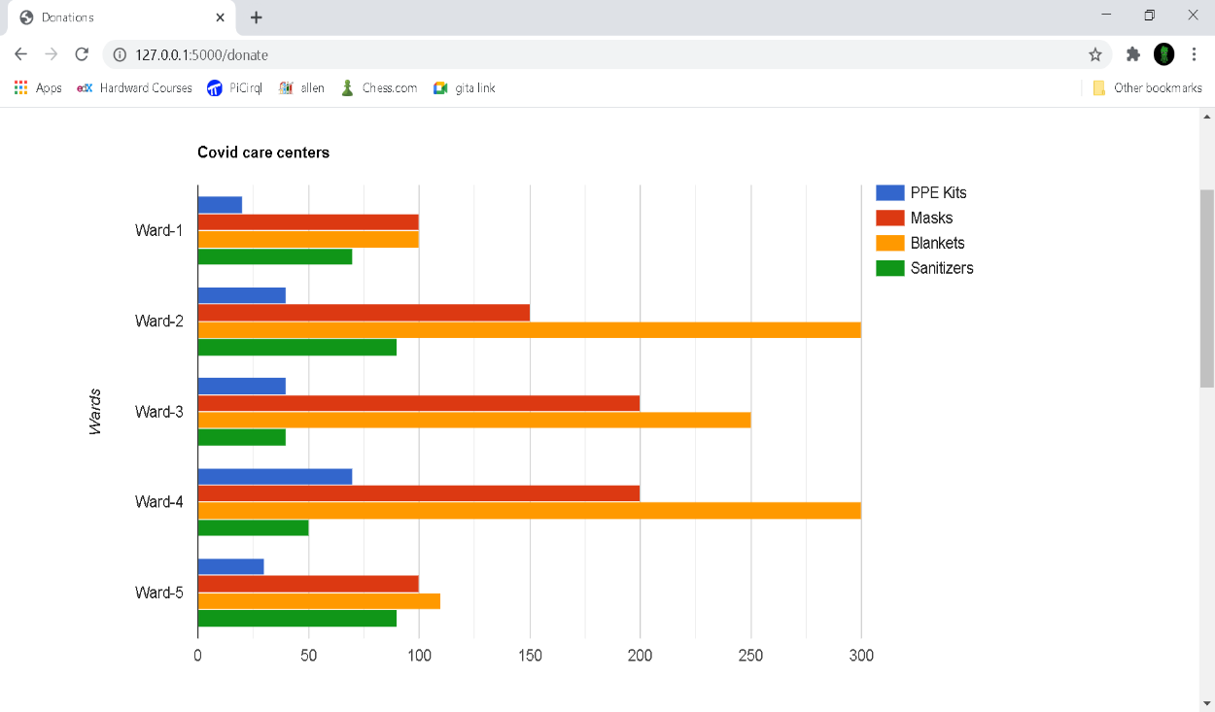
Extend & Seek Help
Each COVID care centre often raises requests for help like PPE kits, masks, blankets, etc (recall simulation program)
Additionally, some individuals can also use our application to ask for help
Crystal Ball displays all these needs and enables donors to pitch in for help

Slide 18
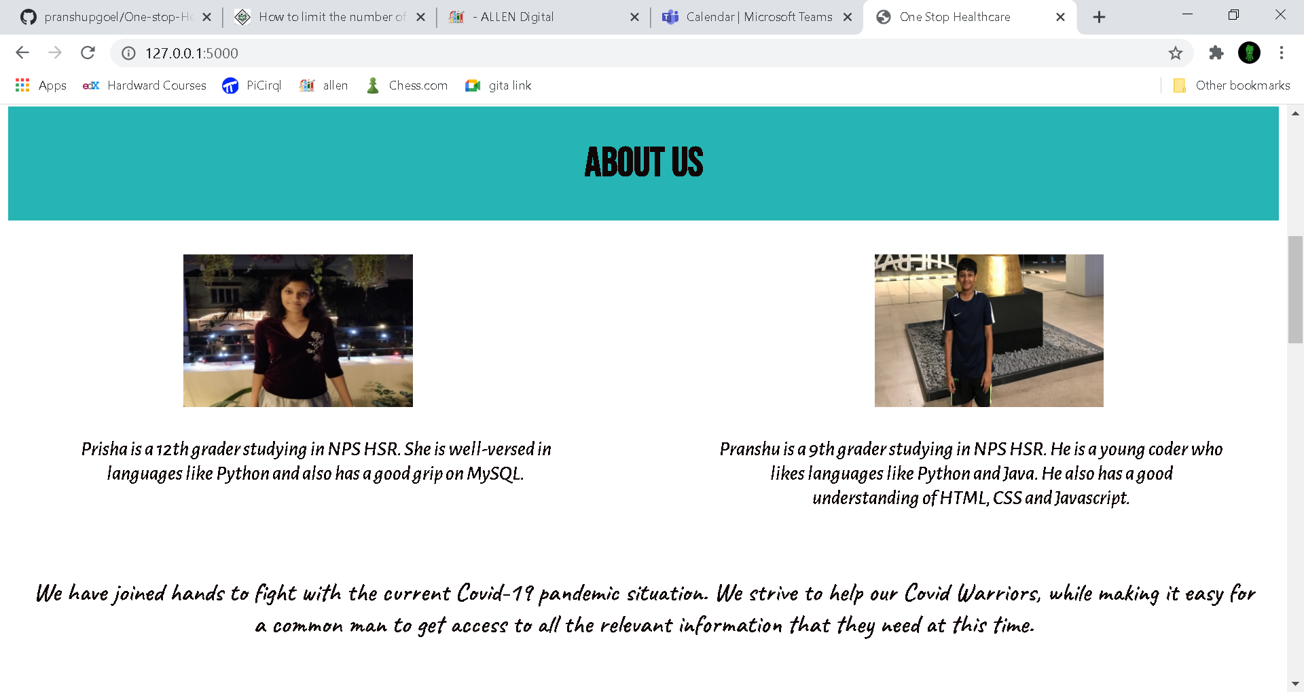

Slide 19
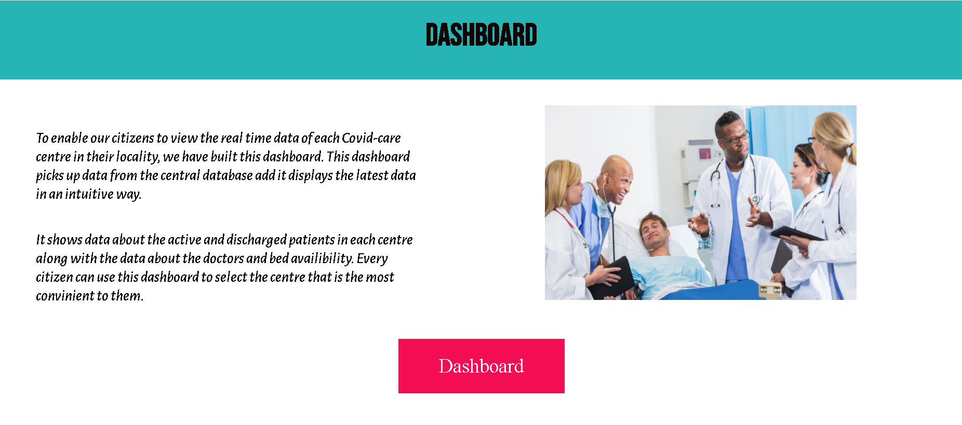

Slide 20
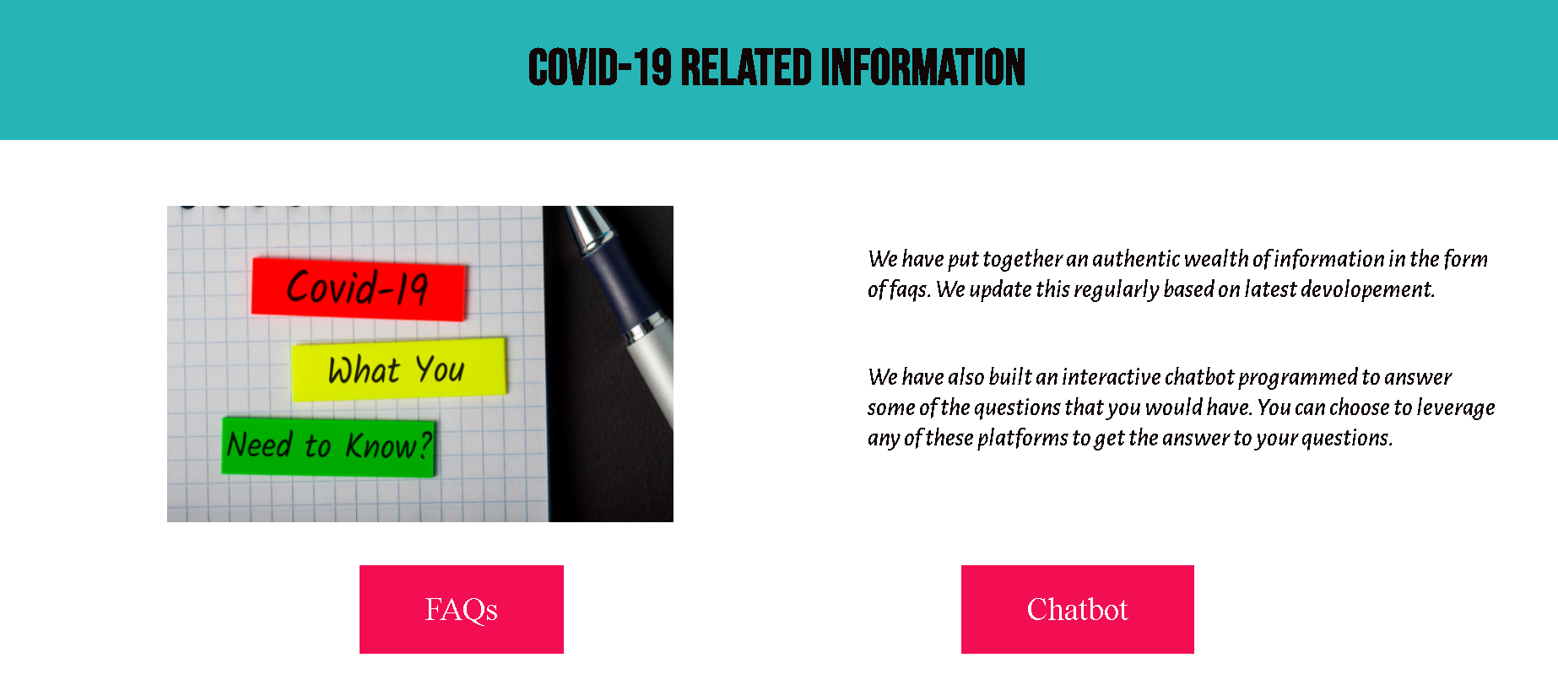

Slide 21
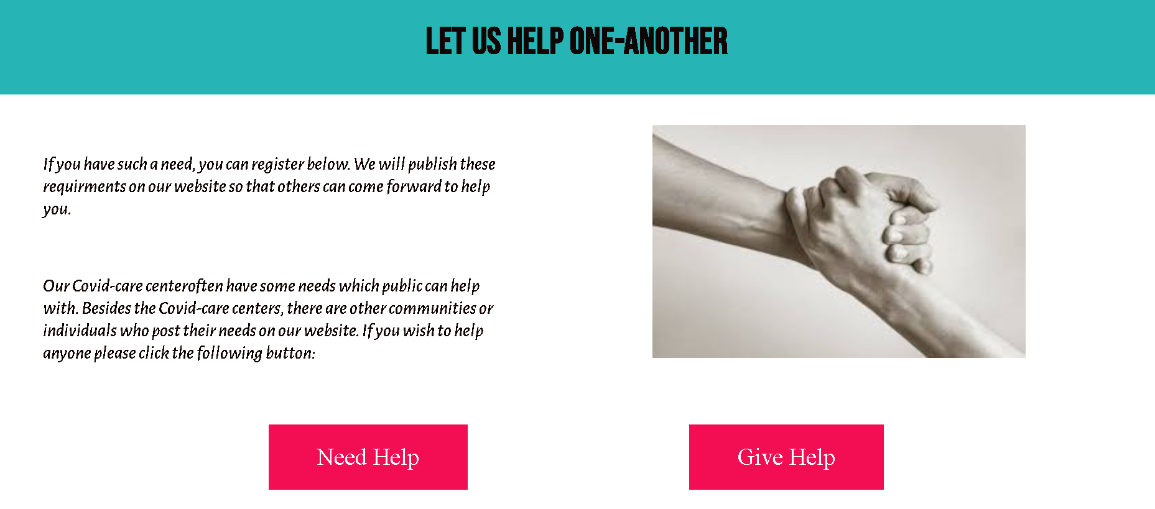

Slide 23
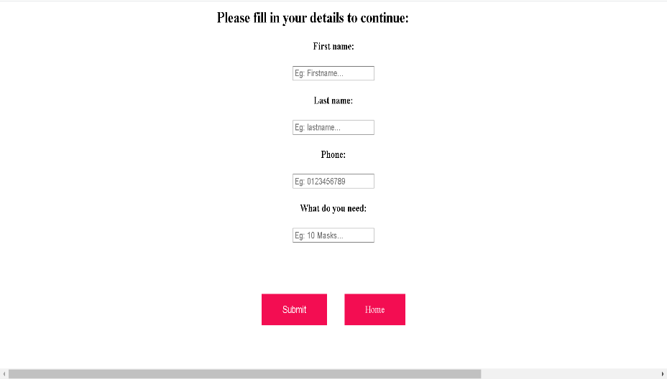

Slide 24
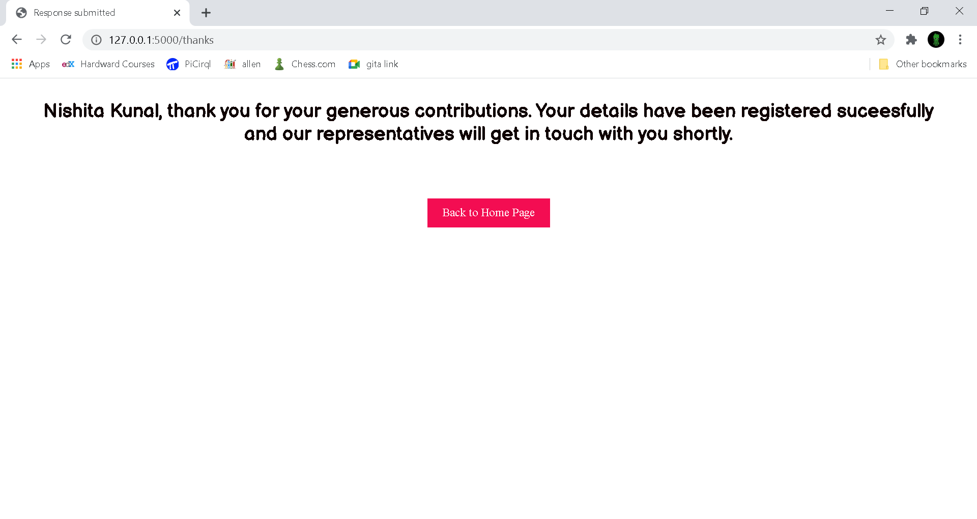

Slide 25
THANK YOU

